Slide 1
SIT374: Project Management
Lecture 8:
Project management (HR & Stakeholder & Communication)

Slide 2
Why Managing People?
People are the most important assets in organizations and on projects. People are the most expensive resource in a project.
A major determinant to project success
A resource that fluctuates
A resource that PM must best manage
What does HR management mean?
Planning human resources
Acquiring the right people
developing the project team
managing the project team

Slide 3
Processes in HR Management
Acquire project team
Develop project team
Manage project team
Plan human resources
Planning
Executing

Slide 4
The Difficult Part…
Bringing the individuals together as a team
Understanding of team dynamics
The process: forming, storming, norming, performing, adjourning
HR management centers around three key areas
Motivation
Influence and power…Please check chapter 9.
Effectiveness

Slide 5
Keeping People Motivated
People loose motivation when they
feel they do not make a difference
do not get proper recognition
are not learning anything new
do not like their coworkers
want to earn more money
How can PM address these issues?
Can a PM address all these issues?

Slide 6
Motivating People
Two types
Intrinsic – if people enjoy a task, they will participate on their own
Extrinsic – otherwise, may participate for a reward or avoid penalties
Many studies on these motivations
Understanding helps PM develop teams
Many known theories

Slide 7
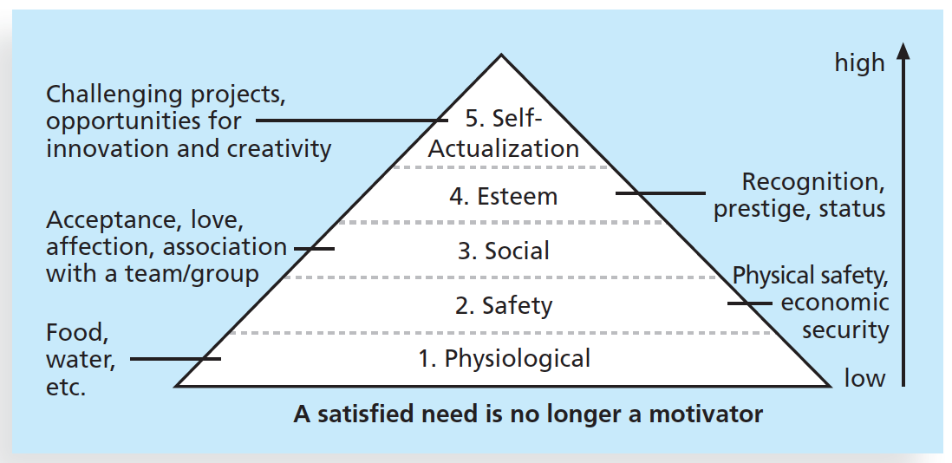
Maslow’s Hierarchy of Needs
People’s behavior motivated by a sequence of needs that evolves over time.
Successful PMs
need to understand
team members’ personal goals and needs to provide appropriate motivation and maximize team performance.
Notes:
Self Actualized people are problem-focused, appreciate life, concerned about personal growth and have the ability to peak experience.
Maslow’s Hierarchy conveys a message of hope and growth.
People can work to control their own destinies and strive naturally to satisfy higher and higher needs.

Slide 8
Herzberg’s Factors
Motivational factors
Achievement, recognition, the work itself, responsibility, advancement, and growth
These factors produce job satisfaction
Hygiene factors
Larger salaries, more supervision, and a more attractive work environment
These factors cause dissatisfaction if not present
But do not motivate workers to do more.
Notes:
Fredrick Herzberg distinguished between motivation factors and hygiene factors when considering motivation in work settings.
Explains why the use of positive factors like wages, time spent on work, providing trainings etc. did not motivate people
Factors like achievement, recognition , responsibility, advancement, and growth job satisfaction and are work motivators.

Slide 9
Other Theories
McClelland’s Acquired-Needs Theory: Proposes that individual specific needs are acquired over time and is shaped by life experiences. The categories if acquired needs include achievement, affiliation and power. Normally one or two of these needs will be dominant in individuals.
McGregor’s Theory X and Y: Theory X (classical Theory) believes that workers dislike and avoid work if possible, so managers must use coercion, threats and other control to get the work done. Theory Y (human relation theory) says that individual inherently do not dislike work, but consider it as natural as play or rest. The most important needs are self-actualization needs for them.
Thamhain and Wilemon’s Theory on Influencing Projects: Investigated the approaches the project managers can use to deal with workers and hence get project success. The nine influence basis as listed below are given as : Authority, Assignment Budget, Promotion, Money, penalty, Work Challenge, Expertise, Friendship.
What do all these theories do for PM?

Slide 10
Activity 1
Which theory do you resonate with most and why?

Slide 11
Improving One-self
Stephen Covey’s 7 Habits of Highly Effective People
Be proactive
Begin with the end in mind: write mission statements to achieve what you want to, focus on values.
Put first things first: project managers focus on important and urgent activities (planning, reading, exercising). Also focus on important but not urgent activities (relationships with stakeholders, mentoring team members.
Think win/win: parties in conflict work together to develop new solutions. But in case of competition we – use win/lose strategy.
Seek first to understand, then to be understood: Empathic Listening - Intent to understand. Project managers need to understand their stakeholder needs and expectations.
Synergize: project teams need to synergize by creating collaborative products that are much better than a collection of individual efforts.
Sharpen the saw (notice how the presentations was ‘sharpened’)?: renew yourself physically, spiritually, mentally, and socially to avoid burnouts. Project managers need to give time to the team to reenergize, retrain and relax occasionally to avoid burnouts.
Notes:
Stephen Covey says that there is one clear sign of win-win, and that's winning by helping others
Win-Win: An entrepreneur who succeeds by delighting his customers

Slide 12
1. Plan human resources
Plan human recourses is the process of identifying and documenting project roles, responsibilities, and reporting relationships.
The main output include the Human Resource Plan.
Sample Human Resource Plan

Slide 13
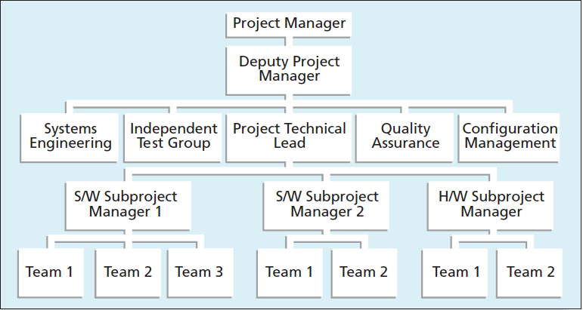
Organizational charts/breakdown structure
Work breakdown structure (WBS) identifies the works to be done.
Organization charts/organizational breakdown structure (OBS) identifies the people that will do the works.
Notes:
Each Task may have multiple R,C, I entries but there can be only one A entry to clarify which individual is accountable for each task.

Slide 14
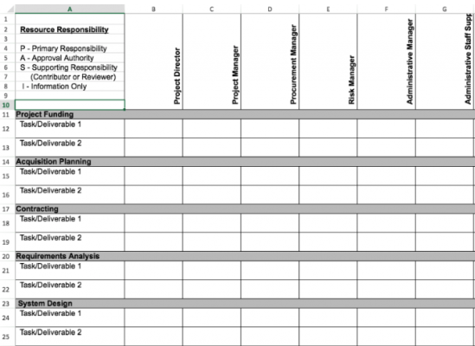
Responsibility Assignment Matrix
A matrix that maps the work of the project (WBS) to the people responsible described in the OBS
An intersection of WBS and OBS
Notes:
Each Task may have multiple R,C, I entries but there can be only one A entry to clarify which individual is accountable for each task.

Slide 15
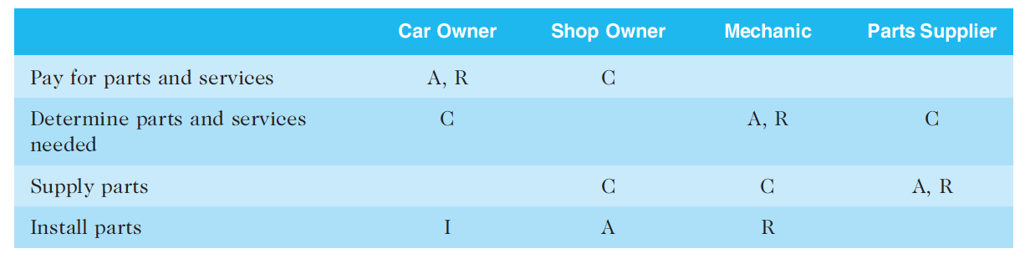
RACI charts
RACI Charts account for (Responsibility (who does the task), Accountability (who signs off on the task or has authority for it), Consultation (who has the information necessary to complete the task), Informed (who needs to be notified of task status/ result).
Notes:
Each Task may have multiple R,C, I entries but there can be only one A entry to clarify which individual is accountable for each task.

Slide 16
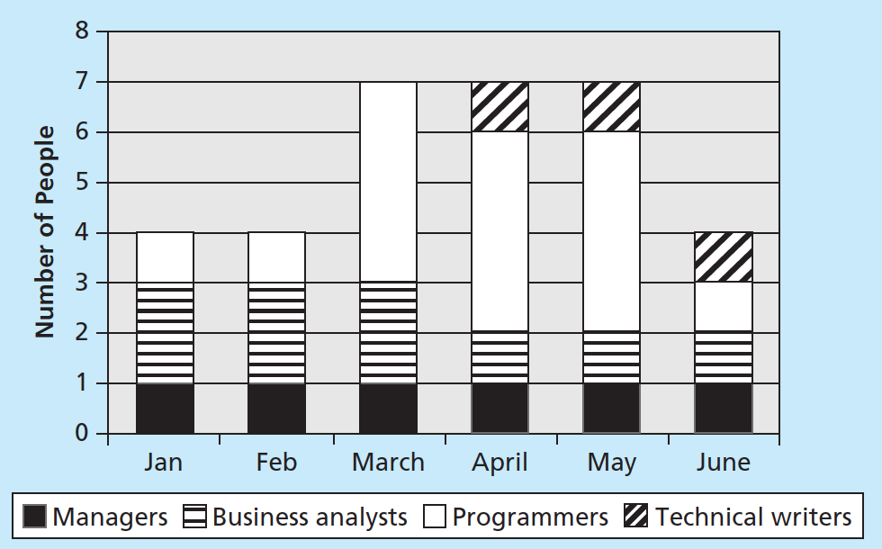
Others
Staffing management plan
Describes when and how people will be added to and taken off the project team
Resource histogram
A column chart that shows
number of resources assigned
to a project over time
(six month IT project)
Notes:
The staff management plan describes the type of people needed to work on the project (programmer, technical writer, business analyst) .
It also describes how the resoruces would be acquired, trained, rewarded and reassigned after the project etc.

Slide 17
Stakeholder management…

Slide 18
Top 10 Project Success Factors
User Involvement
Executive Support
Clear Business Objectives
Emotional Maturity
Optimization
Agile Process
Project Management Expertise
Skilled Resources
Execution
Tools and Infrastructure
Notes:
user involvement is the the factor number 1.

Slide 19
Stakeholder Management?
Identify all people or organizations affected by a project, to analyze stakeholder expectations, and to effectively engage stakeholders.
Some people may lose their jobs when a project is completed. Project managers might be viewed as enemies if the project resulted in job losses for some stakeholders. By contrast, they could be viewed as allies if they lead a project that helps increase profit.

Slide 20
Stakeholder Management Processes
Stakeholder
Register
Identify Stakeholders
Plan stakeholder management
Manage stakeholder engagement
Control stakeholder engagement
Determine Strategies to effectively engage stakeholders in project decision/activities based on their needs, Interests, potential impact
Communicating and working with project stakeholder to satisfy his needs, expectations and fostering engagement for project decisions
Monitoring stakeholder relationships, adjustments plans, and strategies for engaging stakeholders
Internal
vs
External

Slide 21
Plan Stakeholder Management
After identifying and analyzing stakeholders, project teams should develop a plan for management them
The stakeholder management plan can include:
Current and desired engagement levels
Interrelationships between stakeholders
Communication requirements
Potential management strategies for each stakeholders
Methods for updating the stakeholder management plan

Slide 22
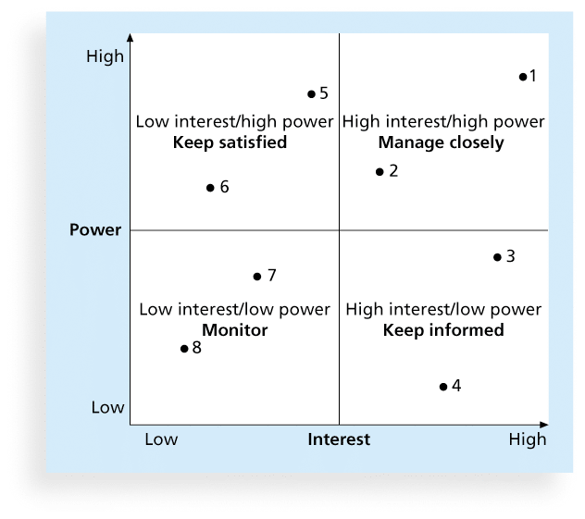
Power/Interest Grid
The Bully
The Meddling
The Overbearing
The Poor
The Untrustworthy
The Indecisive
The Unavailable
Notes:
After identifying the key project stakeholders, you can use classification models to determine the approach for managing stakeholder relationships

Slide 23
Stakeholder Level of Engagement
Unaware: Unaware of the project and its potential impacts on them
Resistant: Aware of the project yet resistant to change
Neutral: Aware of the project yet neither supportive nor resistant
Supportive: Aware of the project and supportive of change
Leading: Aware of the project
Notes:
It is important to measure the engagement level of stakeholders throughout the project
The project manager can take corrective actions if the stakeholder with high interest and high power are categorized as resistant or unaware.
If such stakeholders are unaware or resistant, you need the support of senior management to talk to them directly, understand the reasons for esitance and develop strategy to handle the potential conflicts

Slide 24
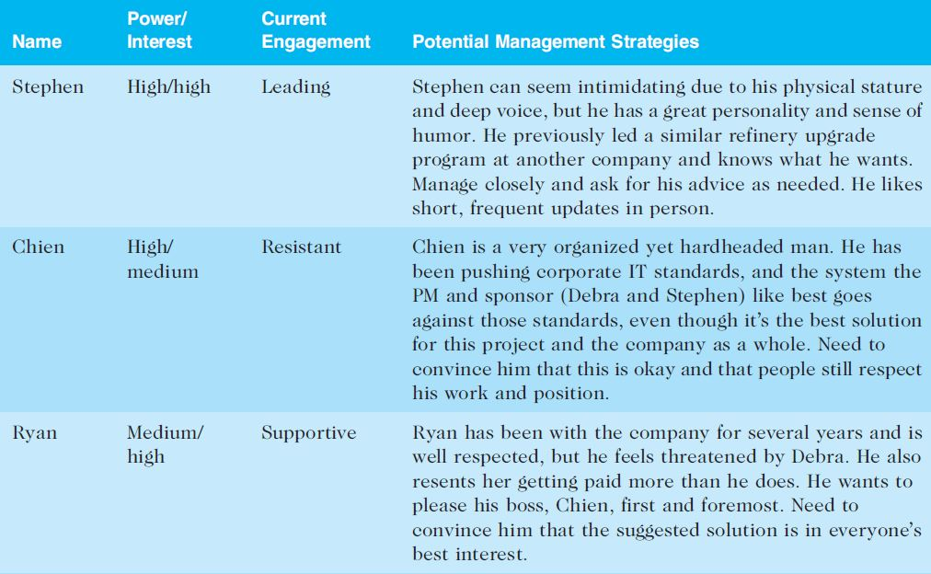
Sample Stakeholder Analysis

Slide 25
Controlling Stakeholder Engagement
You cannot control stakeholders, but you can control their level of engagement.
Invite key stakeholders to participate in project kick-off meeting.
The project schedule should include activities and deliverables related to stakeholder engagement, such as surveys, reviews, demonstrations, and sign-offs.

Slide 26




Project HR/Stakeholder/Communication
Team
Project Manager
Stakeholder
Notes:
In this lecture we cover Human Resources (team), Stakeholders and the communication used with both

Slide 27
Communication Management
Failure to communicate is one of the greatest threats on project success.
Project managers can spend as much as 90 percent of their time on communicating.
The processes required to ensure timely and appropriate generation, collection, distribution, storage, retrieval, and ultimate disposition of project information.
Communication is complex; requiring choices between:
Sender-Receiver models
Choice of media
Choice of style
Presentation techniques
Meeting management

Slide 28
Keys to Good Communications
Project managers say they spend as much as 90 percent of their time communicating
Need to focus on group and individual communication needs
Use formal and informal methods for communicating
Distribute important information in an effective and timely manner
Set the stage for communicating bad news
Determine the number of communication channels

Slide 29
Communication Management Processes
Plan communications
Manage communications
Control communications
Determine the
communication
requirements
of stakeholders
Create, distribute communication based on plan
Monitor and control communications to ensure that stakeholder communication requirements are met

Slide 30
1. Plan communications management
Stakeholder communications requirements
Information to be communicated, including format, content, and level of detail
The people who will receive the information and who will produce it
Suggested methods or technologies for conveying the information.
Frequency of communication
A glossary of common terminologies
Communication Plan is a part of the Project Management Plan

Slide 31
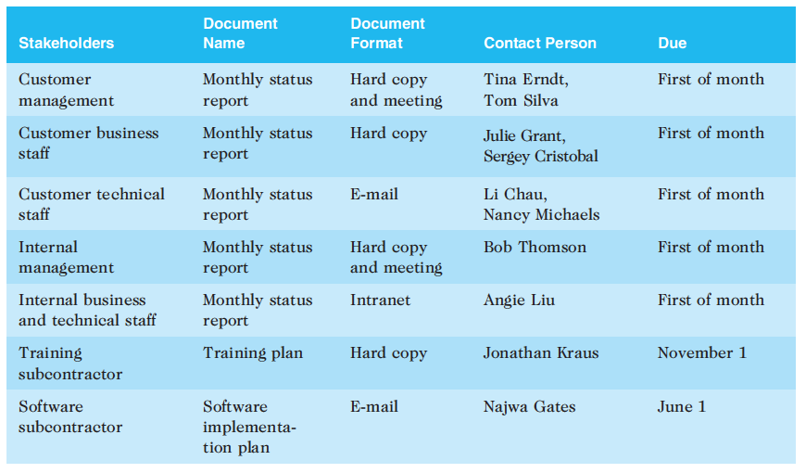
Stakeholder Communication Analysis
Information about the content of essential project communications comes from project WBS.
Many WBSs include project communications
to ensure that reporting key information is a project deliverable

Slide 32
2. Manage communication
Focus: creating and distributing project information /include formal, informal, written, and verbal. It is important to determine the most appropriate means for distributing different types of project information.
Is it sufficient to send written reports for project information? Is text appropriate, or would visuals or even videos communicate the information better? Are meetings alone effective in distributing some project information? Are meetings and written communications both required for project information? What is the best way to provide information to virtual team members?
Notes:
People 3 : channel 3
People 4 : channel 6
People 5 : channel 10

Slide 33
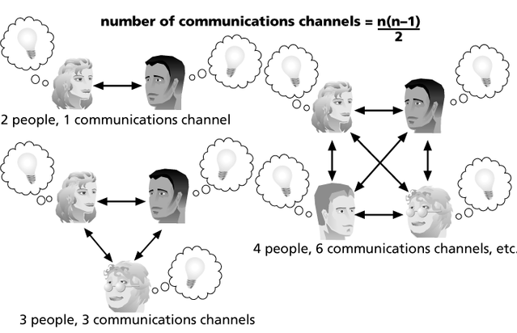
Manage communication
As the number of people that need to communicate increases, the number of communication channels also increases. Number of communication channels: n*(n-1)/2 where n is number of stakeholders for example.

Slide 34
Encouraging More Face-to-Face Interactions
Short, frequent meetings are often very effective in IT projects
Stand-up meetings force people to focus on what they really need to communicate
Some companies have policies preventing the use of e-mail between certain hours or even entire days of the week

Slide 35
Distributing Information in an Effective and Timely Manner
Don’t bury crucial information
Don’t be afraid to report bad information
Oral communication via meetings and informal talks helps bring important information—good and bad—out into the open

Slide 36
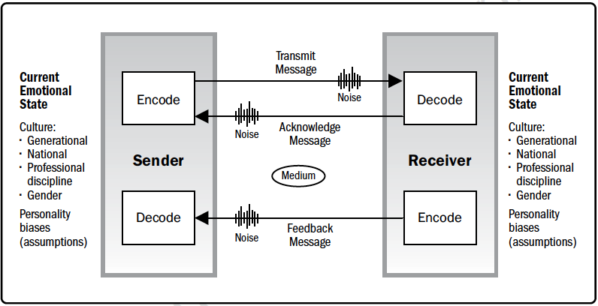
Other Communication Considerations
Rarely does the receiver interpret a message exactly as the sender intended

Slide 37
Other Communication Considerations
Geographic location and cultural background affect the complexity of project communications
Different working hours
Language barriers
Different cultural norms

Slide 38
Using Technology to Enhance Creation and Distribution
Technology can facilitate the process of creating and distributing information, when used properly
It is important to select the appropriate communication method and media

Slide 39
3. Control Communications
The main goal of controlling communications is to ensure the optimal flow of information throughout the entire project life cycle
The project manager and project team should use their various reporting systems, expert judgment, and meetings to assess how well communications are working. If problems exist, the project manager and team need to take action, which often requires changes to the earlier processes of planning and managing project communications
It is often beneficial to have a facilitator from outside the project team assess how well communications are working

Slide 40
Suggestions for Improving Project Communications
Develop better communication skills
Run effective meetings
Use e-mail and other technologies effectively
Use templates for project communications

Slide 41
There’s a Lot More!
How do you handle conflict?
Do you have good email skills?
Can you run effective and efficient meetings?

Slide 42
Activity
Based on the information provided in HR management-Activity 1, identify the issues with analysis and recommendations.

Slide 43
Summary
HR management
Stakeholder management
Communication management

Slide 44
What’s next
Next area of management – quality and procure management

